Slide 1

Manthan 2022
Business plan Template

Slide 2
God’s Eye
(Identifying fake and abusive content in Social Media)
Our Objective:
Our idea is to develop a solution which resists/stops the spreading of adult content, abusive content and fake content in social media platform such as twitter, Instagram, Facebook etc. It would help us to make this world a better place.

Slide 3
Team Details
Our Team:
Surya Narayanan CS - Developer
Rithvikailas G - Administrator
Rubiga SA - Technical Contributor
Shurthika R - Technical Contributor
Mentor: Anand R - Associate Professor

Slide 4
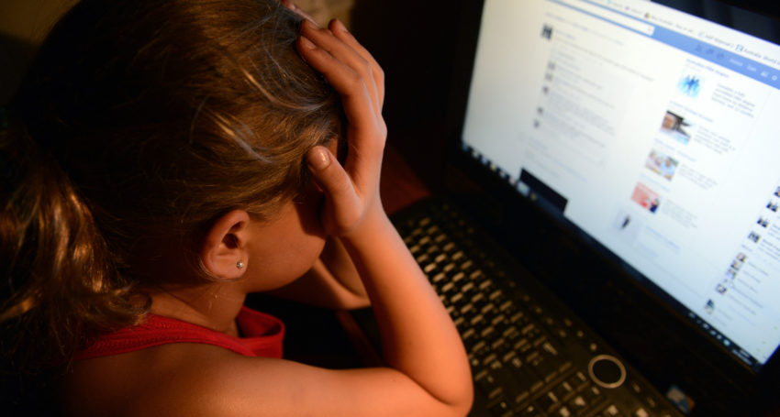
Problem Statement:
As the usage of social media has been increased enormously these days, we are not aware of the content shared in each social media. With the rapid development of face synthesis technology, the security threat brought by face tampering is becoming more and more serious.
It is a fact that we are exposed to adult content, abusive content and fake content. In today’s digital world we see many instances where a particular person is being targeted. Hence we have came with an idea to overcome this problem.

Slide 5
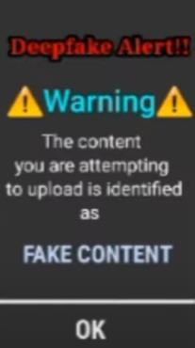
Our Approach towards the problem:
Our project proposes the solution to detect adult content, abusive content and the content that is against to the community guidelines and most importantly will curb such bullying/harassment in cyber space.
Our solution will work on
social media such as Twitter, Facebook, Instagram etc.
will alarm the authorities about the issue.
the end user who is being posted in the social media will notified and has a facility to report such incidents to the authority.

Slide 6
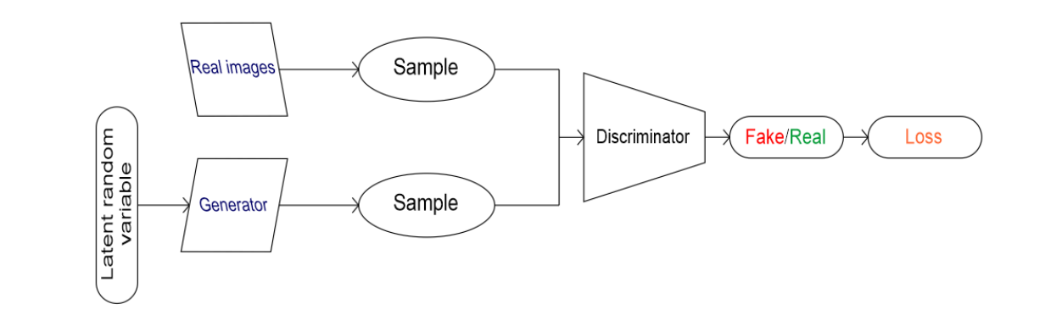
Technical details
Once the user uploads the video, the uploaded video is being split into frames:
Each frames that have been split will be checked for harmful content (adult content) which are against to the community. If it is a harmful content, it automatically intimates the user about the uploaded content and restricts the user to upload the content.
The face was detected in each frames. If the probability of the content being Deepfake is high, it automatically intimates the user about the uploaded content(fake content) and restricts the user to upload the content using our Deep Learning algorithm. Hence spreading of Deepfake content can be drastically minimized.
REQUIREMENTS:
Programming Language – Python
Library :
Open CV
Keras
Tensorflow
Detection:
Dlib
FaceNet
MTCNN
Cloud Service:
AWS

Slide 7
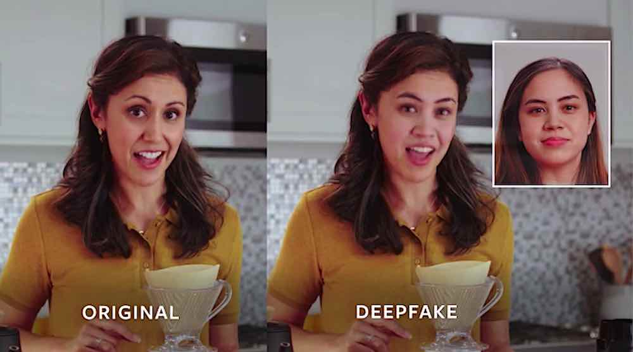
Our Innovation
(Unique Value Proposition)
If a person is being face tempered and posted in social media, the end user who is being affected will be notified about this and the person who posted the fake content will also get notified.
Apart from detecting whether the content is fake or real, our detection algorithm provides a probability whether it is deep fake or not. If the probability of deepfake is high, it automatically intimates the user about it and resists the user to upload the content and also notifies the actual one who is in the content.

Slide 8
Development Status:
An innovation process always starts with the search for and finding innovative potentials and the derivation of ideas. First we thought of detecting the harmful content, while the development was going on we came to an innovative idea of intimating the user about their content using our algorithm which will be much more feasible for this problem.
We have developed a initial prototype and took video of the model to show the working of the model. We are in the development stage of our prototype.
Initially we are building a social media platform to test our extension application by uploading abusive content. It would be a great uprightness to the society if it comes right.
We have took survey on our project and got almost positive reviews. And we have got some suggestions in our project and we will consider the suggestions.

Slide 9
Marketing strategies
Initially we develop our own social media platform which contains our advantage of our project(resisting of fake and harmful content) to show how our project actually works.
Our social media will be presented as a demo to the existing social media to provide a clear idea about our project.
Thereby the other social media will get an idea about our project.
We will market our project by approaching the social media directly.

Slide 10
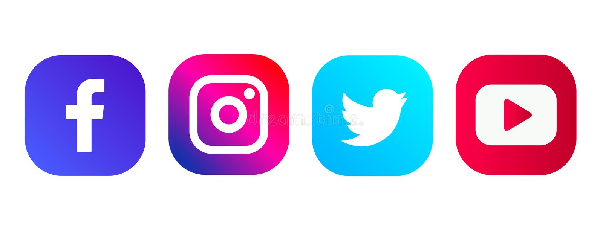
Consumer Segments
Our product is B2B sector based product, hence we are targeting the social media companies like Instagram, Facebook, twitter etc.,. as our customers. This solution will improve the standard of social media, so the users of social media will increase tremendously. So the users will trust the social media thereby it would be beneficial for social media.
We have took survey on our project and got almost positive reviews. And we have got some suggestions in our project and we will consider the suggestions.

Slide 11
Cost Structure:
All the requirements are available in open source, hard work is required to develop the project costs.
Cost Structure:
AWS – ₹3000/year
We will market our project by approaching the social media directly.
Marketing - ₹20000
Subscription cost - ₹2000
DBMS service - ₹4000
Internet costs.
As we are developing a software, investment and the cost of requirements in minimum.
Hard Work > Cost

Slide 12
Customer Segment:
Our product is B2B sector based product, hence we are targeting the social media companies like Instagram, Facebook, twitter etc.,. as our customers. This solution will improve the standard of social media, so the users of social media will increase tremendously. So the users will trust the social media thereby it would be beneficial for social media.
Revenue Stream:
Our product is directly sold to the social media companies, the revenue of the product can be earned via license based.
The cost of our project depends on our start up at the time of publishing the product in the market.
The company can buy the lifetime licence at the starting stage, or can renew his licence after a year in the yearly basis. Since our product is a software, the cost of product will be finalized at a time of launching.

Slide 13

Milestone:
Once this application is developed, the standard of social media will get improved tremendously.
It will stop the spread of abusive and fake content in social media which will lead to the wellness of the society.
Todays young generation will be more focussed on the right things.
It will help the user’s experience in using the social media and in turn will attract the more number of users in social media.

Slide 14
Socio-Economic Impact:
How your innovation is trying to impact society, What kind of social/ economic impact does your innovation have?
Definitely yes, as social media is used by all kind of people from 5 years old to 80 years old, number of beneficiary customers were numerous.
Quantitative/ Qualitative changes which the innovation will bring into the existing scenario:
On considering the employment generation our product doesn’t plays a major role, as it is a software it can be developed and maintained by a small group of people. But there may be a chance of employment generation in the future while upgrading the vision.
Will it empower any sector of society at large?
Millions and millions of people in this world are using social media, hence social media platform is used for spreading many rumours and also morphed adult contents. So, we have developed a solution overcome this issue. Hence everyone who uses the social media can use it fearlessly.

Slide 15
Process:
Once when the user uploads the content to any social media, our algorithm checks for any hate content with our algorithm.
Once any harmful content found, it sends a alert message to the user. It also sends a notification to the person who is being misused in the content.
The end user has the access to report the content and the user.
Our Prototype Model:
https://youtu.be/CaenK7FhmMs
Video Demo:

Slide 16
Thank You

